Slide 1
Button group
Taught by Yossef Ayman Zedan

Slide 2
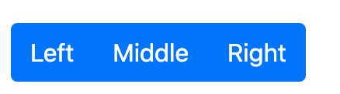
Overview
Group a series of buttons together on a single line or stack them in a vertical column.

Slide 3
Basic example
Wrap a series of buttons with .btn in .btn-group.
<div class="btn-group" role="group">
<button type="button" class="btn btn-primary">Left</button>
<button type="button" class="btn btn-primary">Middle</button>
<button type="button" class="btn btn-primary">Right</button>
</div>

Slide 4
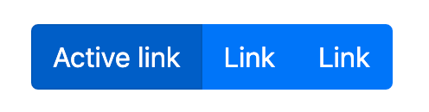
Basic example
Active classes can also be used
<div class="btn-group">
<a href="#" class="btn btn-primary active" aria-current="page">Active link</a>
<a href="#" class="btn btn-primary">Link</a>
<a href="#" class="btn btn-primary">Link</a>
</div>

Slide 5
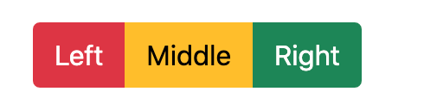
Mixed styles
<div class="btn-group" role="group">
<button type="button" class="btn btn-danger">Left</button>
<button type="button" class="btn btn-warning">Middle</button>
<button type="button" class="btn btn-success">Right</button>
</div>

Slide 6
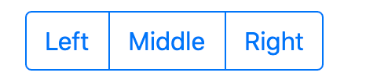
Outlined styles
<div class="btn-group" role="group”>
<button type="button" class="btn btn-outline-primary">Left</button>
<button type="button" class="btn btn-outline-primary">Middle</button>
<button type="button" class="btn btn-outline-primary">Right</button>
</div>

Slide 7
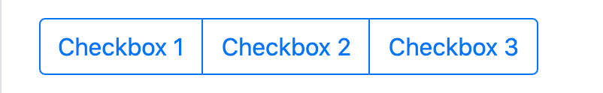
Checkbox button groups
Combine button-like checkbox and radio toggle buttons into a seamless looking button group.
<div class="btn-group" role="group">
<input type="checkbox" class="btn-check" id="btncheck1">
<label class="btn btn-outline-primary" for="btncheck1">Checkbox 1</label>
<input type="checkbox" class="btn-check" id="btncheck2">
<label class="btn btn-outline-primary" for="btncheck2">Checkbox 2</label>
<input type="checkbox" class="btn-check" id="btncheck3">
<label class="btn btn-outline-primary" for="btncheck3">Checkbox 3</label>
</div>

Slide 8
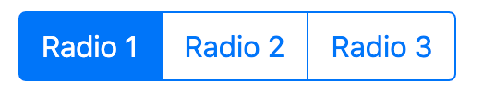
Radio button groups
<div class="btn-group" role="group">
<input type="radio" class="btn-check" name="btnradio" id="btnradio1" checked>
<label class="btn btn-outline-primary" for="btnradio1">Radio 1</label>
<input type="radio" class="btn-check" name="btnradio" id="btnradio2”>
<label class="btn btn-outline-primary" for="btnradio2">Radio 2</label>
<input type="radio" class="btn-check" name="btnradio" id="btnradio3">
<label class="btn btn-outline-primary" for="btnradio3">Radio 3</label>
</div>

Slide 9
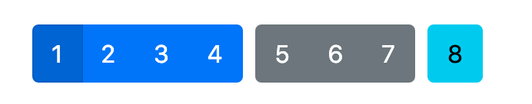
Button toolbar
Combine sets of button groups into button toolbars for more complex components. Use utility classes as needed to space out groups, buttons, and more.
<div class="btn-toolbar" role="toolbar">
<div class="btn-group me-2" role="group">
<button type="button" class="btn btn-primary">1</button>
<button type="button" class="btn btn-primary">2</button>
<button type="button" class="btn btn-primary">3</button>
<button type="button" class="btn btn-primary">4</button>
</div>
<div class="btn-group me-2" role="group">
<button type="button" class="btn btn-secondary">5</button>
<button type="button" class="btn btn-secondary">6</button>
<button type="button" class="btn btn-secondary">7</button>
</div>
<div class="btn-group" role="group">
<button type="button" class="btn btn-info">8</button>
</div>
</div>

Slide 10
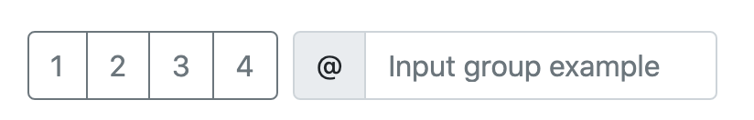
Button toolbar
Feel free to mix input groups with button groups in your toolbars. Similar to the example above, you’ll likely need some utilities though to space things properly.
<div class="btn-toolbar mb-3" role="toolbar">
<div class="btn-group me-2" role="group">
<button type="button" class="btn btn-outline-secondary">1</button>
<button type="button" class="btn btn-outline-secondary">2</button>
<button type="button" class="btn btn-outline-secondary">3</button>
<button type="button" class="btn btn-outline-secondary">4</button>
</div>
<div class="input-group">
<div class="input-group-text" id="btnGroupAddon">@</div>
<input type="text" class="form-control" placeholder="Input group example">
</div>
</div>

Slide 11
Button toolbar
<div class="btn-toolbar justify-content-between" role="toolbar">
<div class="btn-group" role="group">
<button type="button" class="btn btn-outline-secondary">1</button>
<button type="button" class="btn btn-outline-secondary">2</button>
<button type="button" class="btn btn-outline-secondary">3</button>
<button type="button" class="btn btn-outline-secondary">4</button>
</div>
<div class="input-group">
<div class="input-group-text" id="btnGroupAddon2">@</div>
<input type="text" class="form-control" placeholder="Input group example">
</div>
</div>

Slide 12
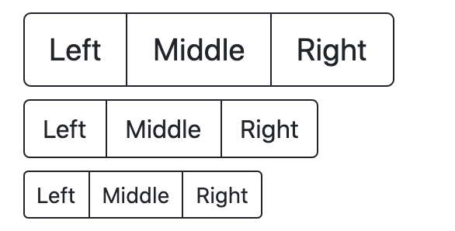
Sizing
Instead of applying button sizing classes to every button in a group, just add .btn-group-* to each .btn-group, including each one when nesting multiple groups.
<div class="btn-group btn-group-lg" role="group">...</div>
<div class="btn-group" role="group">...</div>
<div class="btn-group btn-group-sm" role="group">...</div>

Slide 13
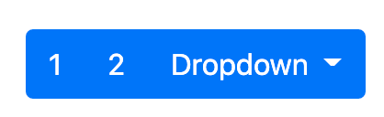
Nesting
Place a .btn-group within another .btn-group when you want dropdown menus mixed with a series of buttons.
<div class="btn-group" role="group">
<button type="button" class="btn btn-primary">1</button>
<button type="button" class="btn btn-primary">2</button>
<div class="btn-group" role="group">
<button id="btnGroupDrop1" type="button" class="btn btn-primary dropdown-toggle" data-bs-toggle="dropdown">
Dropdown
</button>
<ul class="dropdown-menu">
<li><a class="dropdown-item" href="#">Dropdown link</a></li>
<li><a class="dropdown-item" href="#">Dropdown link</a></li>
</ul>
</div>
</div>

Slide 14
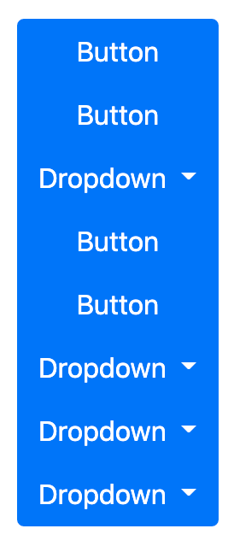
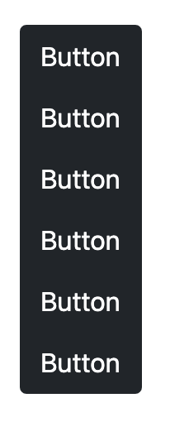
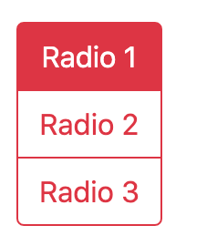
Vertical variation
Make a set of buttons appear vertically stacked rather than horizontally. Split button dropdowns are not supported here.
<div class="btn-group-vertical"> ... </div>

